Slide 1
Access(ed) Poetry. The Graph Poem Project and the Place of Poetry in Digital Humanities
The Graph Poem Team (University of Ottawa):
Chris Tanasescu (MARGENTO)
Diana Inkpen
Vaibhav Kesarwani
Bryan Paget

Slide 2
Graph Theory Essentials
A graph is a collection of vertices (points) that are connected by edges (lines).
Formally: A graph is an ordered pair G = (V, E) comprising a set V of vertices or nodes or points together with a set E of edges or arcs or lines, which are 2-element subsets of V (i.e. an edge is associated with two vertices, and that association takes the form of the unordered pair comprising those two vertices). To avoid ambiguity, this type of graph may be described precisely as undirected and simple.
Examples: WWW, Social Media, molecules in chemistry, etc.

Slide 3
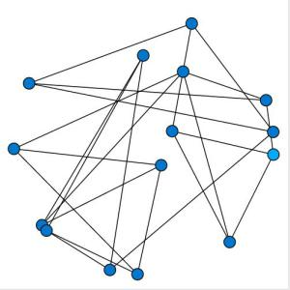
Graph Theory Essentials

Slide 4
Why Apply Graph Theory in Poetry?
Find a formalized way to represent and analyze poems within and across poetry corpora
Process automatically large poetry datasets in the age of big data/data-intensive research, distant reading, “the big unread,” etc.
By studying specific features of a poetry graph we will find out extremely useful and sometimes surprising things about various poetry corpora potentially relevant to researchers in lit criticism & theory, poetics, lit history, DH, computational linguistics, cultural studies, cultural analytics, etc.
Developing apps useful in creative writing
Also (or mainly), because I had this crazy idea back in 2010
Well, SSHRC gave us funding to do it…

Slide 5
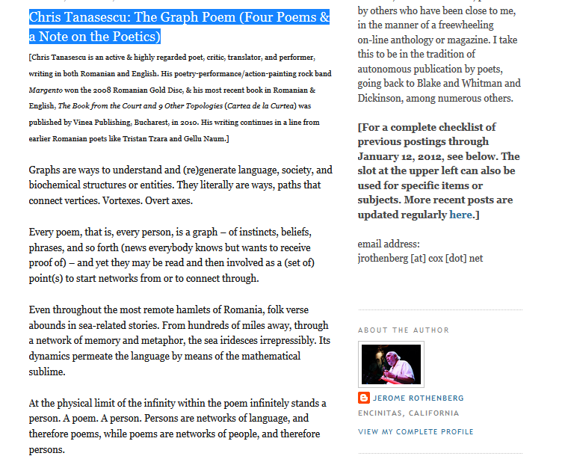
“The Graph Poem (Four Poems and a Note on the Poetics)” http://poemsandpoetics.blogspot.ca/2011/03/chris-tanasescu-graph-poem-four-poems.html

Slide 6
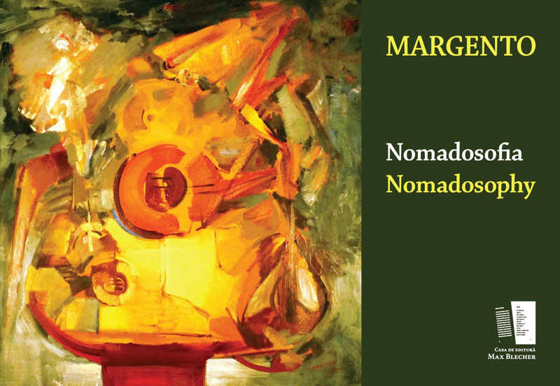
A manually assembled graph poem
MARGENTO. (2012). Nomadosofia (poem graf) /Nomadosophy (a graph poem). Max Blecher Press.

Slide 7
MARGENTO--Nomadosophy
"Margento is a caravan, a circus, a symphony, and a brawl. It is a global, multi-languaged, powerful performance troupe made of more than fifty poets (from Darwish to Ly Doi, Levine to Ng to Oeur) working in a brand-new kind of theater. And its conductor, impresario, and visionary puppet-master is the brilliant Romanian poet and performer Chris Tanasescu. In his hands, in his head, and with his orchestration, poetry comes vitally alive in a shared, communal, polyphonic, and charged new way - rich with political aptitude and buzzing with lyrical pizzazz - as it seeks to remember our many origins, roaming on toboggans, fishing boats, and taxicabs alike, and searching for a place for the night. Songs alongside footnotes, tiny imagist poems loaded like bombs inside rangy prose documents, lyrics within dramatics within call-and-response meta-texts, the four primary "poems" of Nomadosofia cover the globe with poetry that leaps over borders, from erotic to elegiac, holy to profane, formal to wildly improvised, ancient yet as new as the latest zip-drive. If you want to hear a poetry as representative, as capacious, and as timely as is humanly possible, turn on Nomadosofia and, I predict, soon you'll be singing along. Everyone's welcome." David Baker

Slide 8
Computational Tools and Apps
Topic classifier: “Multilabel Subject-Based Classification of Poetry.” Andrés Lou, Diana Inkpen, and Chris Tanasescu (Margento) (2015) http://www.aaai.org/ocs/index.php/FLAIRS/FLAIRS15/paper/viewFile/10372/10322
Meter and rhyme: “Automatic Classification of Poetry by Meter and Rhyme.” Chris Tanasescu (Margento), Bryan Paget, and Diana Inkpen (2016) www.aaai.org/ocs/index.php/FLAIRS/FLAIRS16/paper/download/12923/12883
Metaphor detection and processing: “Metaphor Detection in a Poetry Corpus” by Kesarwani, Inkpen, Szpakowicz, and Tanasescu (Margento) presented at ACL2017
Rhyme classifier and visualization app: Vaibhav Kesarwani
Syntax classifier, enjambment processing: Blair Drummond

Slide 9
Metaphor Detection in a Poetry Corpus
Vaibhav Kesarwani, Diana Inkpen,
Stan Szpakowicz, and Chris Tănăsescu (Margento)

Slide 10
Type 1 Metaphor
Part of Speech (POS) tag sequence of “noun-verb-noun” or “noun-verb-determiner-noun”
The verb is a copula such as is, are, was, were, be, am.
Examples:
Machines are the animals of the humans
Words are a weight
Eyes are lakes

Slide 11
Type 2 Metaphor
Part of Speech (POS) tag sequence of “noun-verb-noun” or “noun-verb-determiner-noun”
The verb is any non-copular verb: eats, runs, played, ………
Examples:
The war absorbed his energy
My car drinks gasoline
Money flows like liquid

Slide 12
Type 3 Metaphor
Part of Speech (POS) tag sequence of “adjective-noun”
Examples:
He had some dark thoughts
She is a sweet girl
We also propose types 4 “noun-verb” and 5 “verb-verb” (examples on the next slide), to be included in our future work.

Slide 13
New Manually Annotated Dataset: Metaphor in Poetry
680 lines of English poems from the Poetry Foundation (PoFo) website.
340 as training data and 340 as test data.
Two annotators labelled them as metaphor or not. Initially, kappa value was 0.39 and agreement 66.79%.
After involving a third annotator kappa increased to 0.46 and agreement to 72.94%.
Majority vote used in the cases of disagreement.

Slide 14
Metaphor Examples in Poetry
Type 1: As if the world were a taxi, you enter it
Type 2: I counted the echoes assembling, thumbing the midnight on the piers
Type 3: The moving waters at their priestlike task
Type 4: The yellow smoke slipped by the terrace, made a sudden leap
Type 5: To die – to sleep

Slide 15
Rule Based Method (Neuman et al.)
Concrete-Abstract rule : Noun1 is concrete & noun2 is abstract
Eg : Eyes are strangers
Concrete-Class Overlap rule : If both noun are of concrete class, check for hypernym overlap
Eg : My lawyer is a shark
WordNet is used to find the noun classes and the hypernyms

Slide 16
Our Method: Use Word Embeddings
GloVe model (trained on the Gigaword corpus) is used to get word vectors of word1 and word2.
Features for Classification:
Word Vector Difference
Cosine Similarity
PMI (Pointwise Mutual Information)
ConceptNet Overlap
We use Weka to classify based on these features.

Slide 17
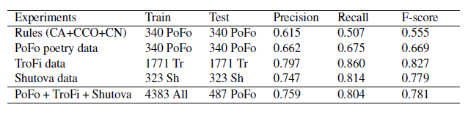
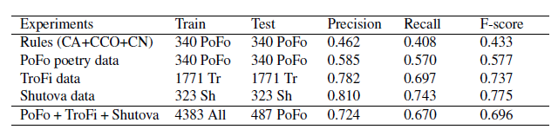
Results
Results for the class metaphor
Results for the class non-metaphor

Slide 18
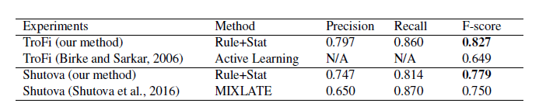
Direct comparison with related work
After comparing TroFi best method and Shutova’s best method to our best method, we reached the conclusion that our statistical ML method is the best.

Slide 19
Challenges
Distinguish between common-speech and “poetic” metaphors
Identify metaphor networks within poems and across corpora based on:
(related) words shared,
syntactic structure (models 1-5 above),
vector difference between tenor and vehicle (basis for quantification)
Try type-independent metaphor detection.
Try Deep Learning classifiers (like CNN) to further improve classification results.

Slide 20
“Impossible” Goals for Future Work
“But, soft! What light through yonder window breaks?/ It is the east, and Juliet is the sun.”
( Romeo and Juliet, Act 2, Scene 2)
“[A]lthough these metaphors, including “Juliet is the sun” can be interpreted in the local context of the lines in which they appear, they are much more meaningful when interpreted in the broader context of Act 2, the entire play, and cultural conventions associated with the metaphor field, X IS LIGHT.” (L. David Ritchie 2013)

Slide 21
In-house Word Embeddings
Example for “love”
GloVe
Our team
'me', 0.7382814884185791
'passion', 0.7352137565612793
'my', 0.7327210307121277
'life', 0.7287958860397339
'dream', 0.7267668843269348
'you', 0.7181721925735474
'always', 0.7111517786979675
'wonder', 0.7094581127166748
'i', 0.7084634900093079
'dreams', 0.7067317962646484
'mind', 0.7063043117523193
'friends', 0.7039859890937805
'true', 0.703278124332428
'loves', 0.7004990577697754
'feel', 0.6982083320617676
'happy', 0.6980456113815308
'fun', 0.6974729299545288
'kind', 0.6957338452339172
'soul', 0.6952477693557739
'she', 0.695054829120636
'joy', 0.7908298373222351
'sorrow', 0.7825886011123657
'hope', 0.7809766530990601
'desire', 0.7641990780830383
'grief', 0.7590593099594116
'despair', 0.7423785328865051
'delight', 0.7373297214508057
'pleasure', 0.7297002077102661
'beauty', 0.7295374274253845
'pain', 0.7292711734771729
'bliss', 0.7288357019424438
'hate', 0.7155698537826538
'pity', 0.7142465710639954
'true', 0.7092820405960083
'comfort', 0.706379234790802
'shame', 0.7017462849617004
'passion', 0.7008419036865234
'faith', 0.697124719619751
'fear', 0.6971151232719421
'hunger', 0.6946554183959961

Slide 22
Automatic Poetry Classification by Rhyme
Vaibhav Kesarwani, Diana Inkpen
and Chris Tănăsescu (Margento)

Slide 23
Types of Rhymes Identified
Positional:
End rhyme
Internal rhyme
Phonemic:
Full rhyme
Slant rhyme
Identical rhyme
Eye rhyme
Rich rhyme

Slide 24
Method
CMUDict (CMU Pronouncing Dictionary) is an open-source machine-readable pronunciation dictionary for North American English that contains over 134,000 words and their pronunciations.
Pronunciation is fetched for all words in a poem:
PROCESS P R AA1 S EH2 S
PROCESS(1) P R AO1 S EH2 S

Slide 25
Poem Phoneme Matching
Title : Summer begins to have the look
Author : Emily Dickinson
"Summer begins to have the look",
"Peruser of enchanting Book",
"Reluctantly but sure perceives",
"A gain upon the backward leaves ",
"Autumn begins to be inferred",
"By millinery of the cloud",
"Or deeper color in the shawl",
"That wraps the everlasting hill.",
"The eye begins its avarice",
"A meditation chastens speech",
"Some Dyer of a distant tree",
"Resumes his gaudy industry.",
"Conclusion is the course of All",
"At most to be perennial",
"And then elude stability",
"Recalls to immortality."
S_AH1_M_ER0 B_IH0_G_IH1_N_Z T_UW1#T_IH0#T_AH0 HH_AE1_V DH_AH0#DH_AH1#DH_IY0 L_UH1_K
AH1_V#AH0_V EH0_N_CH_AE1_N_T_IH0_NG#EH0_N_CH_AE1_N_IH0_NG B_UH1_K
R_IH0_L_AH1_K_T_AH0_N_T_L_IY0 B_AH1_T SH_UH1_R P_ER0_S_IY1_V_Z
AH0#EY1 G_EY1_N AH0_P_AA1_N DH_AH0#DH_AH1#DH_IY0 B_AE1_K_W_ER0_D L_IY1_V_Z
AO1_T_AH0_M B_IH0_G_IH1_N_Z T_UW1#T_IH0#T_AH0 B_IY1#B_IY0 IH2_N_F_ER1_D
B_AY1 AH1_V#AH0_V DH_AH0#DH_AH1#DH_IY0 K_L_AW1_D
AO1_R#ER0 D_IY1_P_ER0 K_AH1_L_ER0#K_AO1_L_ER0 IH0_N#IH1_N DH_AH0#DH_AH1#DH_IY0 SH_AO1_L
DH_AE1_T#DH_AH0_T R_AE1_P_S DH_AH0#DH_AH1#DH_IY0 EH2_V_ER0_L_AE1_S_T_IH0_NG HH_IH1_L

Slide 26

Rhyme Score
Consecutive Rhyme: When rhyme is present in consecutive lines.
Alternate Rhyme: When rhyme is present in alternate lines.
Distant Rhymes: Separated by more than one line; recurrent rhymes across a poem, a collection, oeuvre(s), corpora.
For each word :
Total RhymeScore for a poem:
RhymeScore_{total} = ∑ {RhymeScore_{word}}
Normalization needs to be done for this score, so that a longer poem does not have advantage over a shorter one.
RhymeScore_{norm} = RhymeScore_{total} / norm_{f}

Slide 27
Classification
Classes used for classification: full, slant, identical, rich, eye, internal
Dataset contains 12,831 poems from Poetry Foundation
“Plotly” visualization framework used for graph visualization
Visualization done on 2D/3D scatter plots for each poem based on the RhymeScore metric

Slide 28
“Impossible” Goals for Future Work
Process all sonic techniques—alliteration, consonance, assonance, echoic features, etc.
Quantify euphony
Automated distinction between euphony and cacophony
Consolidating numerical and non-numerical sound-based commonalities

Slide 29
Web Application Demo

Slide 30
Meter Classifier

Slide 31
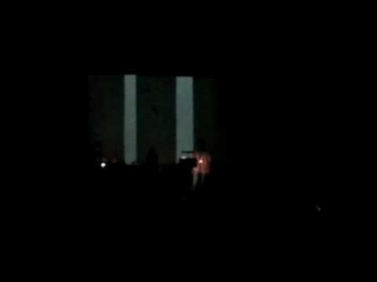
The GraphPoem as Cross-artform Performance
The 1st European Poetry Slam Festival, Berlin 2009; festival opening performance
https://www.youtube.com/watch?v=TXLbPj38MUY

Slide 32
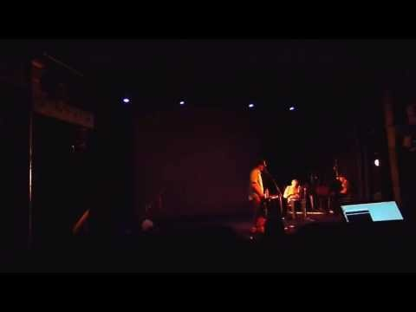
The Graph as Inter(-Re)Mediated (Post)Digital (Re)Performance Poetry
The Electronic Poetry Conference, Kingston U, London, 2013
Re-performance and re-enactment involving re/dis-placement & remediation that translates the graph poem as a processual corpus into postdigital negotiations, alternations, and con-fusion(s) between real and documented, between the artificially (and therefore mediated) “unmediated” and successive layers/stages of gradated and hybridized inter(-and-re)-mediation.
https://www.youtube.com/watch?v=NJ2G_4OmJ_c

Slide 33
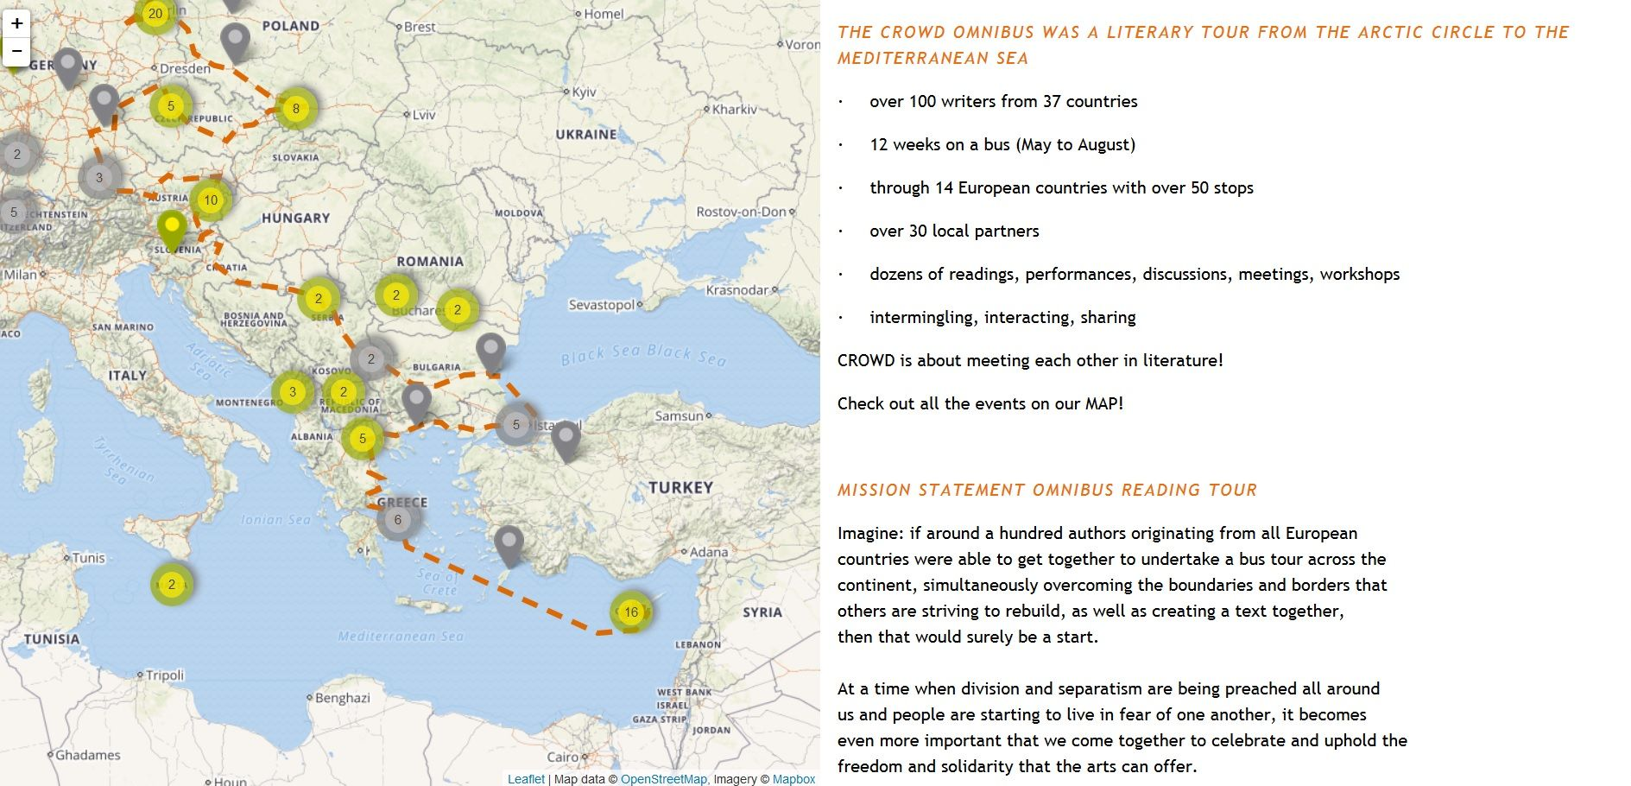
CROWD (CReating Other Ways of Dissemination) Omnibus Literary Tour (2016) http://crowdlitbus.eu/#/start

Slide 34

CROWD http://crowd-literature.eu/one-is-a-crowd-margento/

Slide 35
Access… to Data
Access to/assemblage and critique of corpora/datasets/databases:
What is the data intensive threshold in poetry (difference between 100, 12,000, and 100,000 poems)?
Some researchers’ account of data collection is opaque (“various sources”); others uncritically employ the same (small) datasets as others (e.g. Dalvean after Kao & Jurafsky);
Significant exceptions (Lisa Marie Rhody: “[B]alancing recuperative strategies for including much higher representations of poetry by women with a competing acknowledgment that the representation of work by women in the collection remains unsatisfactory.”)

Slide 36
Data Made “Accessible”
Raw data is an oxymoron; data is rhetorical (L. Gitelman); the GraphPoem: critique of the PoFo database, annotation, and browser;
Critique of the algorithmic and the computational (K. Bode); “making, critique” (N.K. Hayles & J. Pressman)—in the GraphPoem we developed our own (poetry-based) word embeddings, while critiquing open-access tools like GloVe;
Data—scraped and cleaned: conversion to and curation of computationally friendly/(re)formatted/remediated data

Slide 37
“Accessible” Tools & Projects; New Media—New Genre(s)?
C. Rybak, “Poetry” in Digital Pedagogy…; poetry projects in Reading Modernism w| Machines (eds. Ross & O’Sullivan); Poemage; “born digital” poetry—“messy and antithetical (automated, computer-generated poetry?), but offers students fresh entry points into interpreting the algorithmic as creative” (Rybak);
The txtual condition (M. Kirschenbaum)—the challenges of storing and managing e-lit in library collections; for the GraphPoem, the challenge of processing and applying graph theory in digital poetry;
(Non)access in digital poetry; Chris T. Funkhouser, IBM poetry--restriction in computer poems.

Slide 38
Is DH+1 Doable in Computational Poetry?
“N+1”— “So here is my program for the digital humanities. I hope digital humanists can build more experimental, cross-domain corpora designed on purpose to be other than tidy. Digital humanists should make corpora that mix disciplines, provenances, formats, metadata structures, and so on to remix the evidence of the human.” (A. Liu) How do we do this in ways other than simply concatenating projects? How would, for instance, “Modeling Dialogism in The Waste Land” (A. Hammond et al) converge with The GraphPoem?
How could hyperobjects (T. Morton) exceeding the established interpretive lens frames of the author, work, generation, movement, etc., converge with “poems as non-textual and even non-cultural objects—that is, as things in the world divorced from the human agents that created them and outside of the human agents that experience them.” (B.K. Stefans)

Slide 39
The (Non-)Accessible Qualitative; the Aporetic or Sophistic Meaning
Are the qualitative and the quantitative always the two sides of the coin? “Either/or” or informing each other? “Sociologists who use QNA [quantitative narrative analysis] approach the challenge of the context of textual data by focusing on the qualitative decisions in quantitative text analysis. I could not find an analog among distant reading approaches as currently used by Moretti, but Roel Popping argues that mechanized and manual ‘coding is based on a qualitative decision that everybody should understand’.” (T. McMillan Cottom)
“But digital humanists also have nonquantitative ways of putting the meaning problem. One is the idea of models... [L]arge discourse networks (visualized through such tools as Gephi) are comprehensible when their scope or detail is kept low but otherwise grow into beautifully mystifying galaxies of nodes and links.” (A. Liu)
Network graphs are developed with quantitative or quantified data; in the GraphPoem, the edges represent both quantified and non-quantified/non-numerical commonalities. Analyzing the mathematical features of graphs in corpus analysis—is that quantitative or qualitative?

Slide 40
The Non-accessibility of the Poem
Figures of “speculative prosody.” “[W]hile […] explaining some aspects of a poem’s power—its reality effects—most likely the absence or presence of these features does not intersect with any element of the poem’s ‘meaning’.” (B.K. Stefans) Categories of poetic operation that exist outside of, even as they intersect with, the tradition of schematizing the production of meaning through analyses of the lexical, grammatical, and phonological activities of individual poems. Can we commit the “sacrilege” of computing that? Computing undecidability, indeterminacy, and recursion. But they’re already a part of our algorithms & (statistical) computational methods…
“In information ecology the basis for cooperation and survival is differentiation and not similarity. This is the difference between a network and a collective.” (F. Stalder) We track down special poem-nodes by means of computing commonalities.

Slide 41
(Non-)Access Problematized as the Unconscious…
… Of natural language, in traumas of code (N.K. Hayles)
… Of the internet. “The internet is a work of literature.” (S. Baldwin) The great beyond [the screen]. “The googlization of literature.” (L. Emerson)
Processing all digital space as a graph(poem); will the GraphPoem have to cover/become the WWW?

Slide 42
To be continued…
http://artsites.uottawa.ca/margento/en/
Thank you ☺ Questions and comments?

